Slide 1
ML on Technical Analysis Indicators
Thomas B. (Data Science), Joshua L. (Data Science), Jaden H. (Data Science)
Using Technical Analysis Indicators as features and applying machine learning to them identify the patterns of the indicators that accurately predicts future stock price directionality

Slide 2
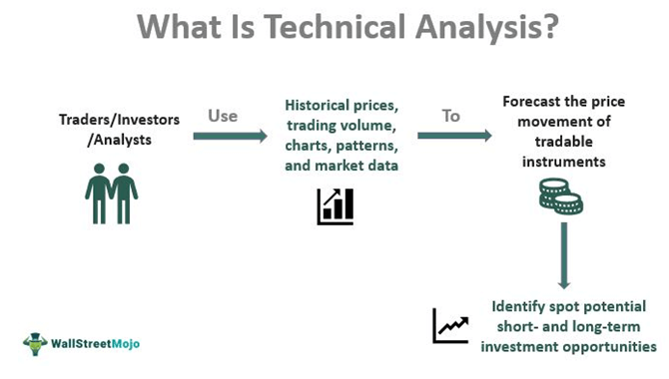
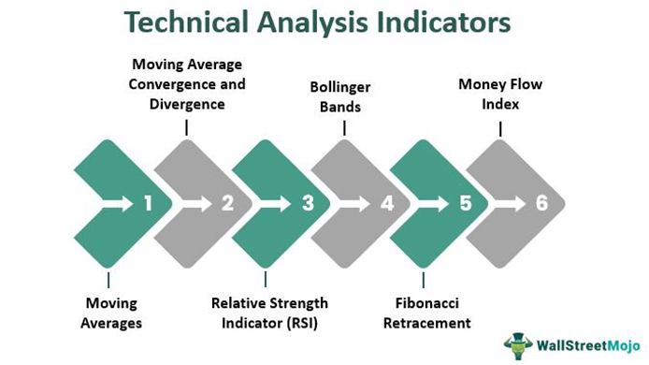
Intro to Technical Analysis and Indicators
Technical Analysis: Using the historical price and volume data of a stock to predict its future movement, and find investment opportunities.
Technical Analysis Indicators: Mathematical calculations or visual representations of various aspects of price and volume data.
https://www.wallstreetmojo.com/technical-analysis/

Slide 3
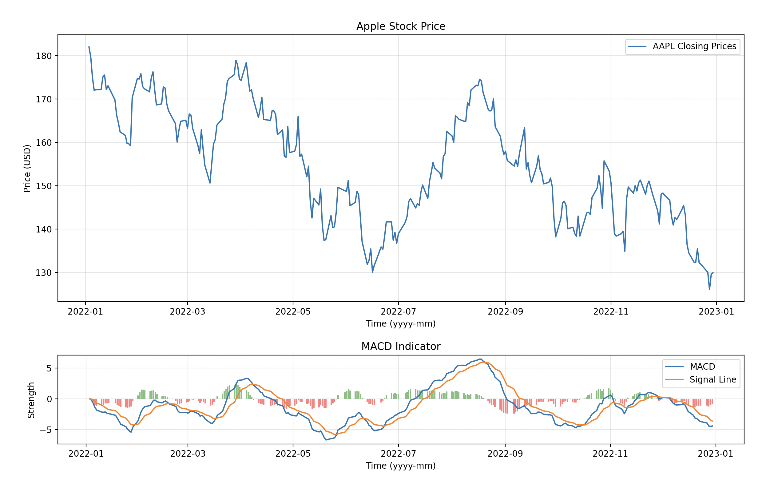
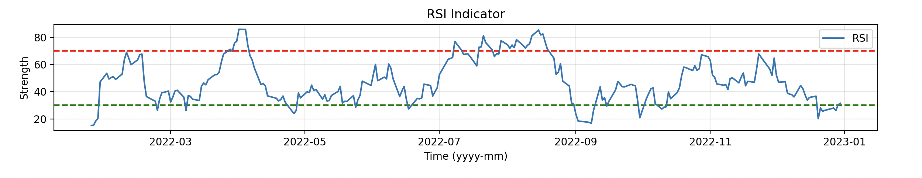
MACD and RSI
MACD (Moving Average Convergence Divergence):
Trend-following momentum indicator
Calculated by subtracting a longer-term Exponential Moving Average (EMA) from a shorter-term EMA.
RSI (Relative Strength Index):
Momentum oscillator that measures the speed and change of price movements.
Ranges from 0 to 100
Values under 30 indicate the stock is underbought
Values over 70 indicate the stock is overbought

Slide 4
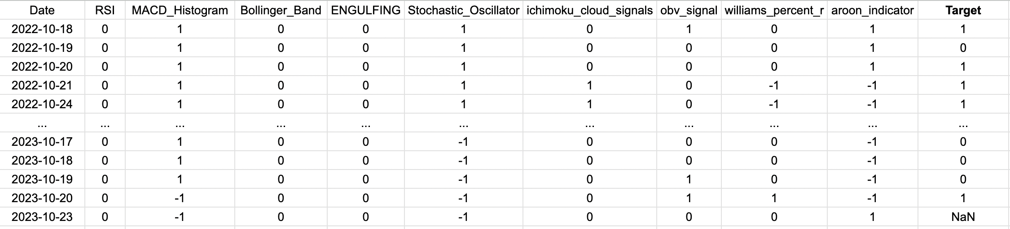
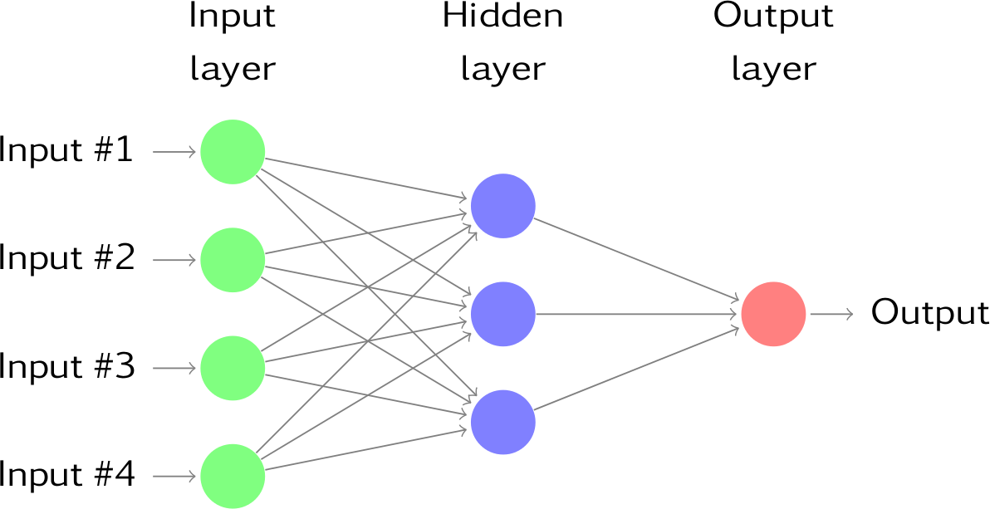
Feature Engineering
ML Model
Intro to Neural Networks
Neurons are organized in layers: input, hidden, and output.
Weights and biases are used for learning.
Activation functions introduce non-linearity.
Forward propagation calculates the output.
The trained model then makes predictions.
https://docs.google.com/spreadsheets/d/1YAj9R4-VQK78Gd9r__s28aec3rs6UpL2wLCXb058vr8/edit#gid=0

Slide 5
Thank You
Q&A

